Slide 1

ADULT CENSUS INCOME PREDICTION
HOUSE PRICE REDICTION
BY,ARUN SHANKAR OVHAL
IT VEDANT THANE

Slide 2
PROJECT NAME-HOUSE PRICE PREDICTION NAME-ROHINI HEMRAJ BHONDEKAR IT VEDANT THANE
Description:
In this notebook, The objective of this project is to develop a predictive model that accurately estimates house prices based on various property attributes. .
The dataset we are going to use is the House Price Prediction dataset from Kaggle which contains about 50,000 rows and 6 features.
This project focuses on developing a predictive model for house prices using various machine learning algorithms.

Slide 3
Motivation:
Accurately predicting house prices is essential for making smart investment decisions in real estate. This project uses machine learning to find the best algorithm for predicting house prices based on features like size, bedrooms, bathrooms, neighborhood, and year built. By comparing different algorithms, we aim to find the most accurate model. This will help buyers, sellers, and real estate professionals make better decisions with reliable price estimates.

Slide 4
Features Description:
Column ID | Column Name | Description
1 | SquareFeet | size of the houses
2 | Bedrooms | number of bedrooms
3 | Bathrooms | number of bathrooms
4 | Neighborhood | Neighborhood types displayed
5 | YearBuilt | shows the year each house was built
6 | Price | prices of the houses

Slide 5
Step 0: Load libraries and dataset
import numpy as np
import pandas as pd
import matplotlib.pyplot as plt
import seaborn as sns
from sklearn.model_selection import train_test_split
from sklearn.metrics import classification_report, accuracy_score
import warnings
warnings.filterwarnings("ignore")
from sklearn.preprocessing import StandardScaler, LabelEncoder

Slide 6
Step 1:Importing Dataset
df=pd.read_csv(r"D:\Uday DATA\DATA SCIENCE PRACTISE\Machine Learning\Project\House (1).csv")
df

Slide 7
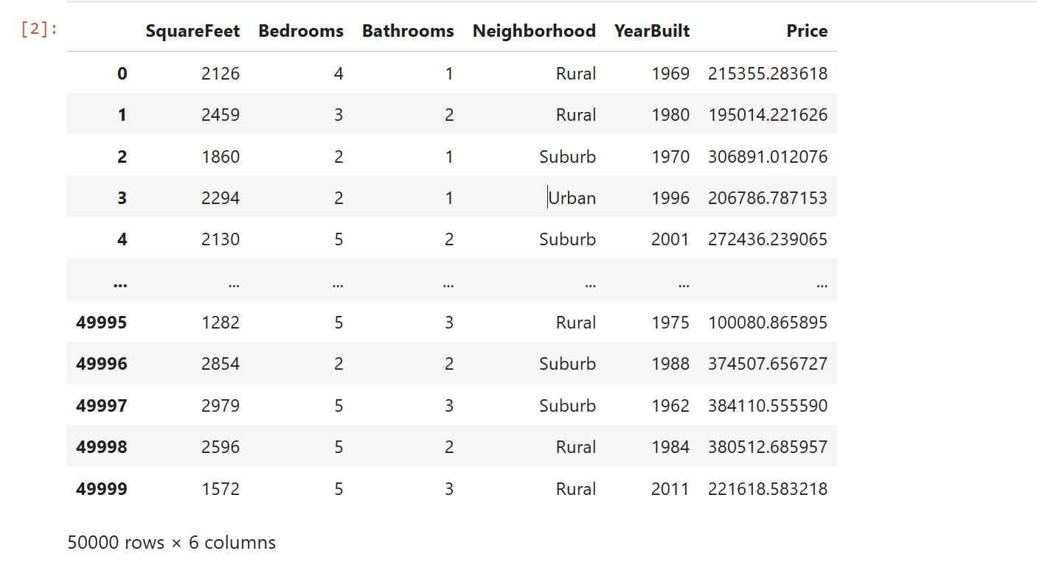
loading the dataset
data=pd.read_csv("housing_price.csv")data

Slide 8
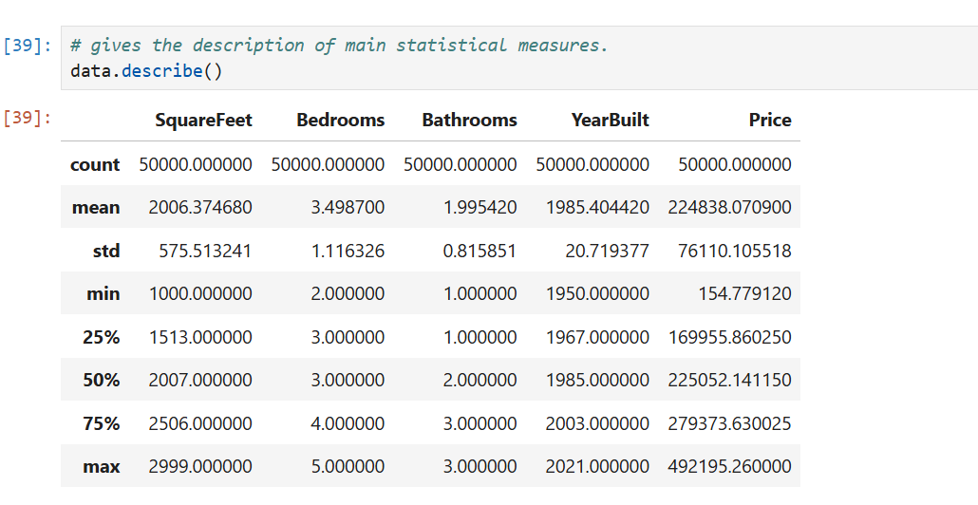

Slide 9
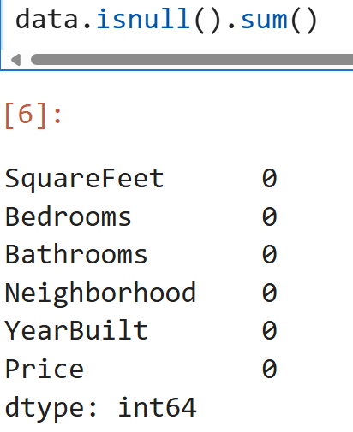
Step 2: Exploratory Data Analysis
Observations:
The dataset doesn't have any null values,

Slide 10
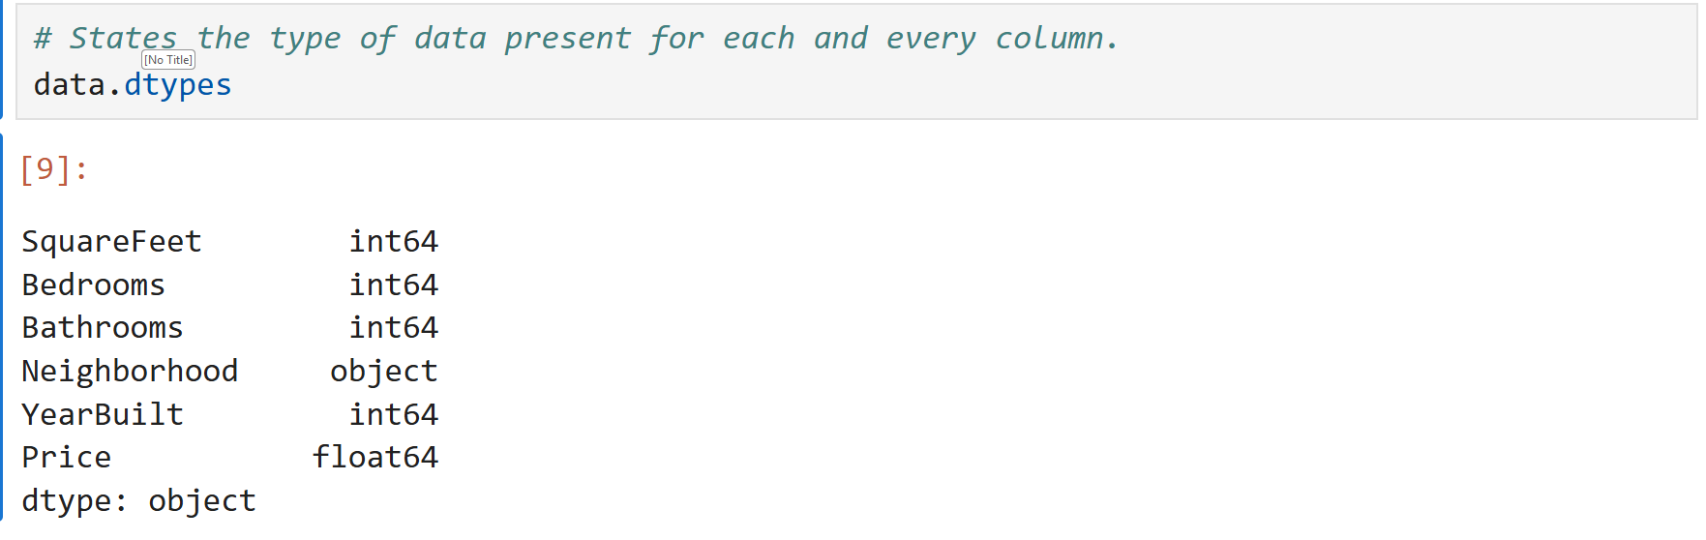

Slide 11
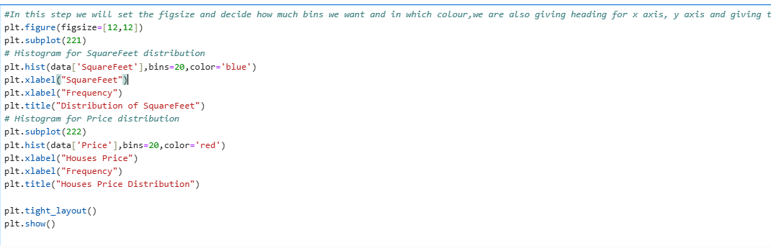
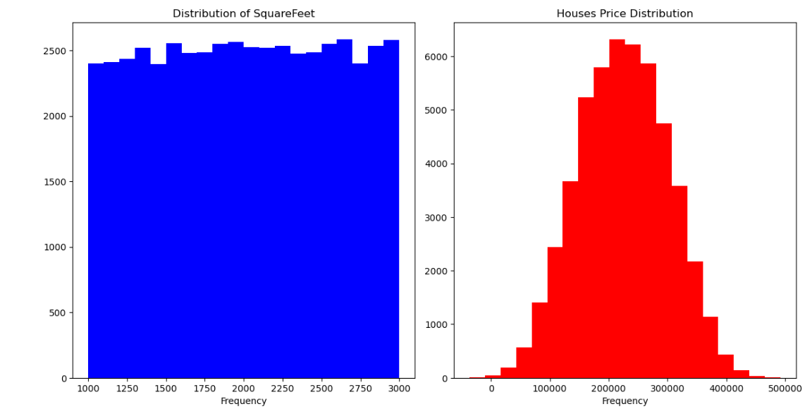
Step 2.1:Visualization

Slide 12
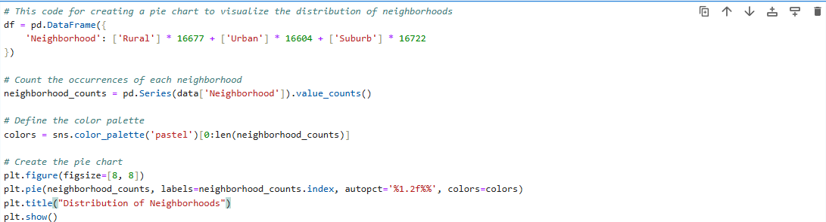
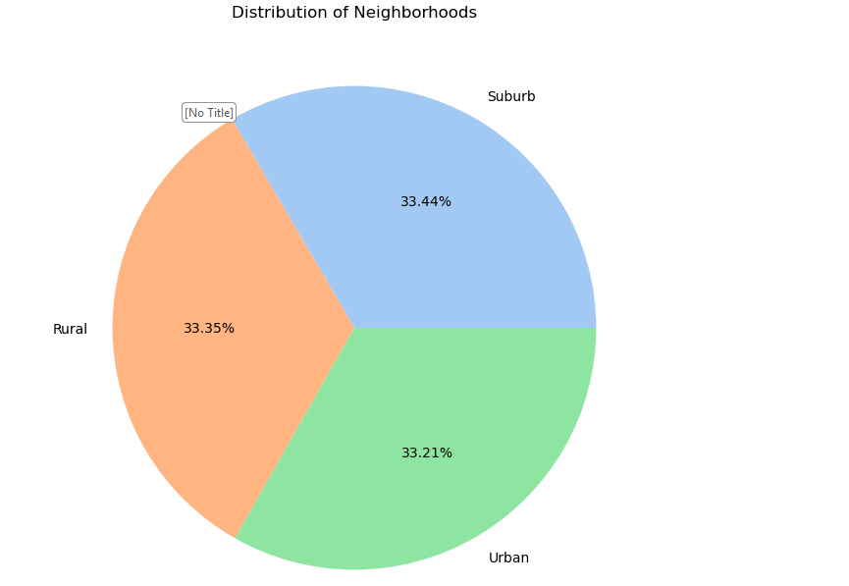

Slide 13
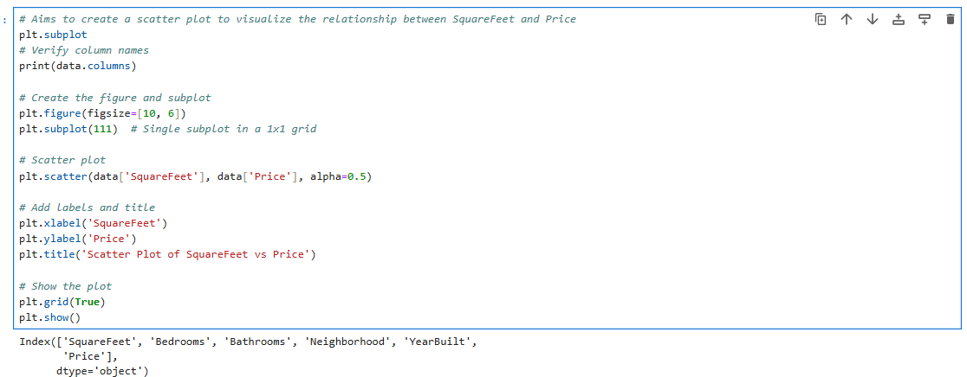
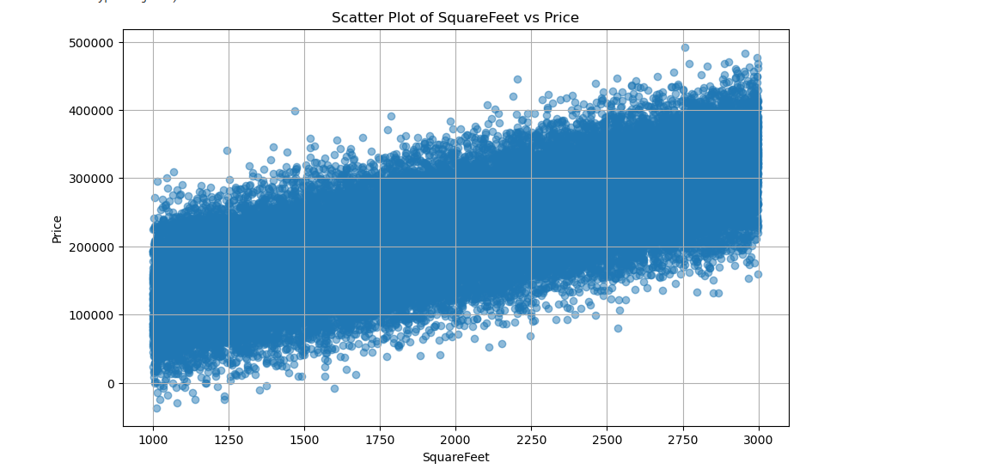

Slide 14
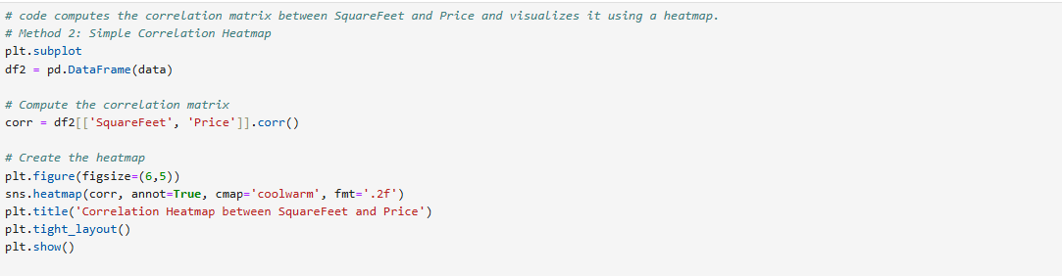
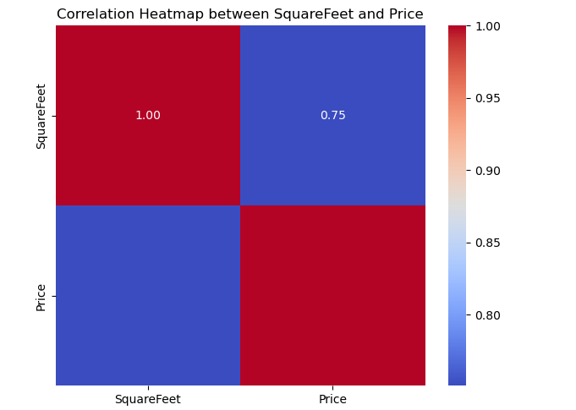

Slide 15
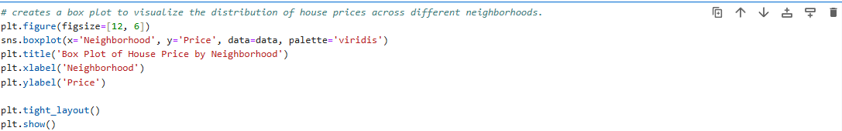
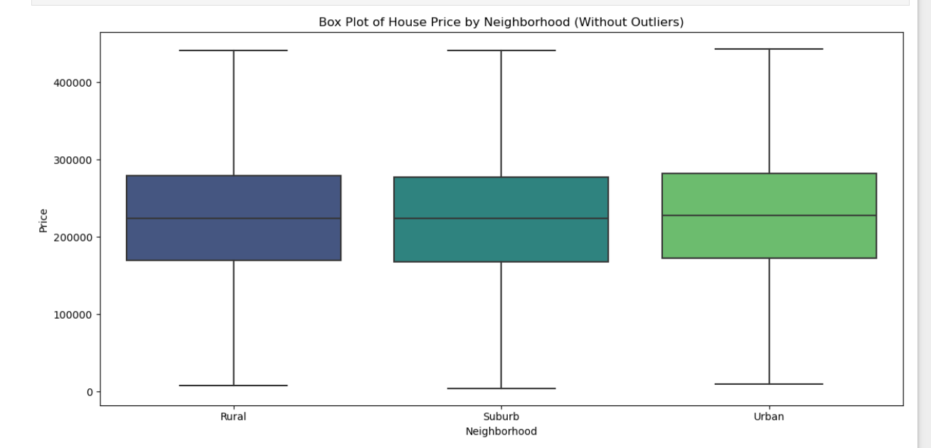

Slide 16
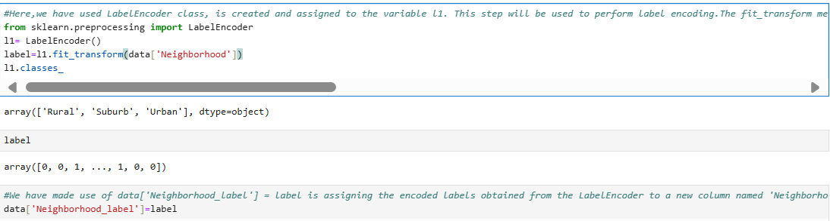
step 2.3: Using Label Encoder for converting category data into numeric

Slide 17
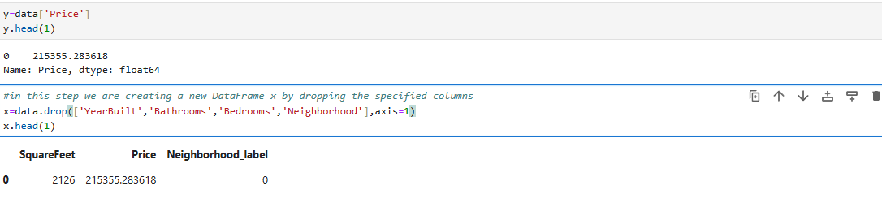
step 2.5: Creating dependent and independent variable

Slide 18
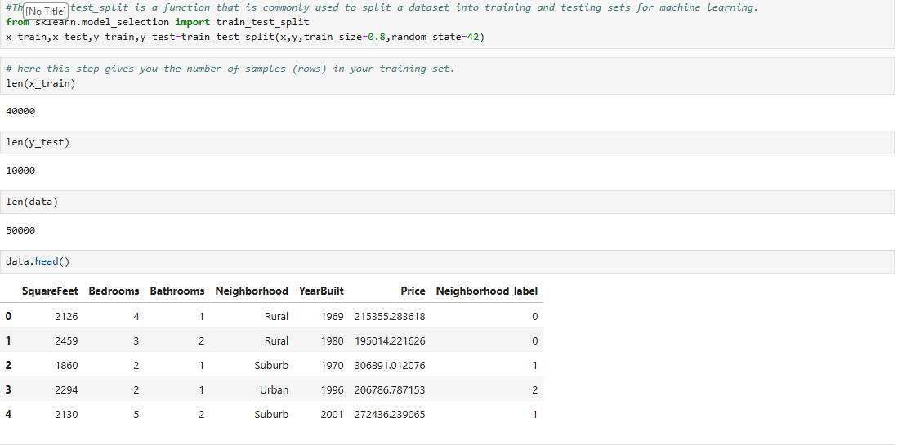
step 3: Model Evaluation

Slide 19
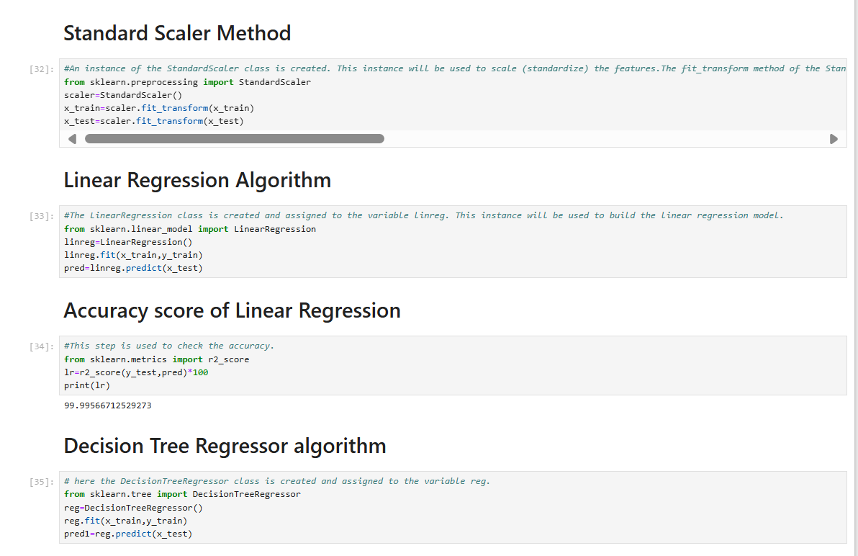

Slide 20
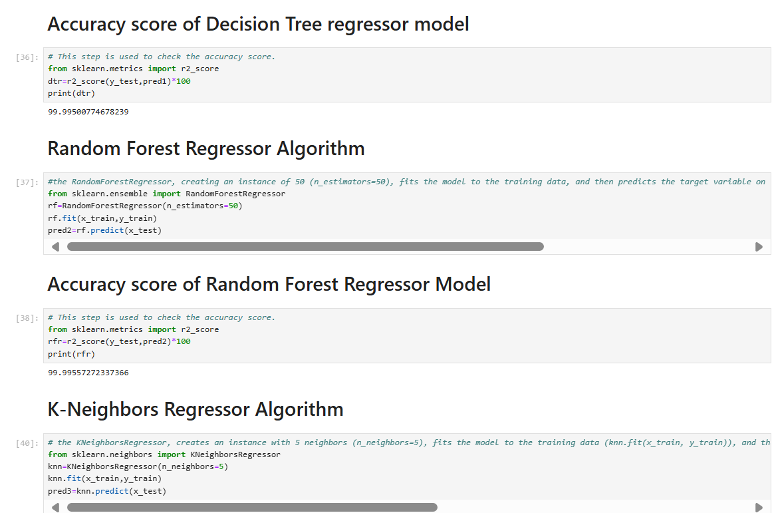

Slide 21
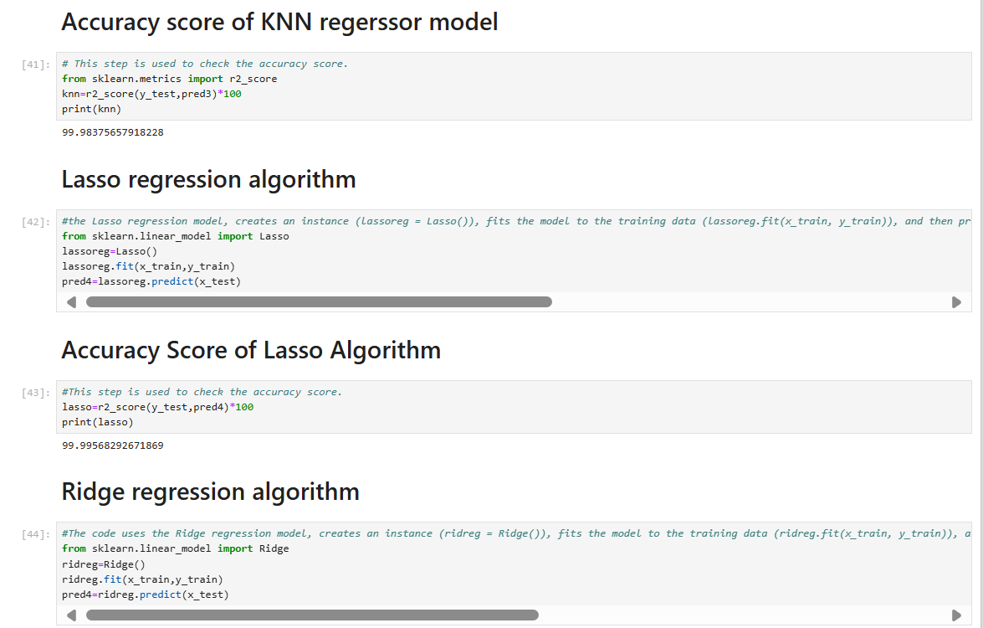

Slide 22
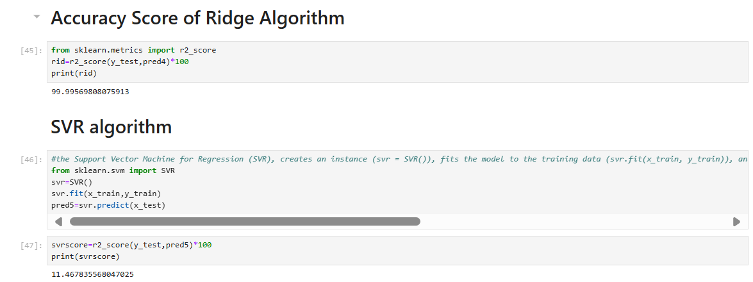

Slide 23
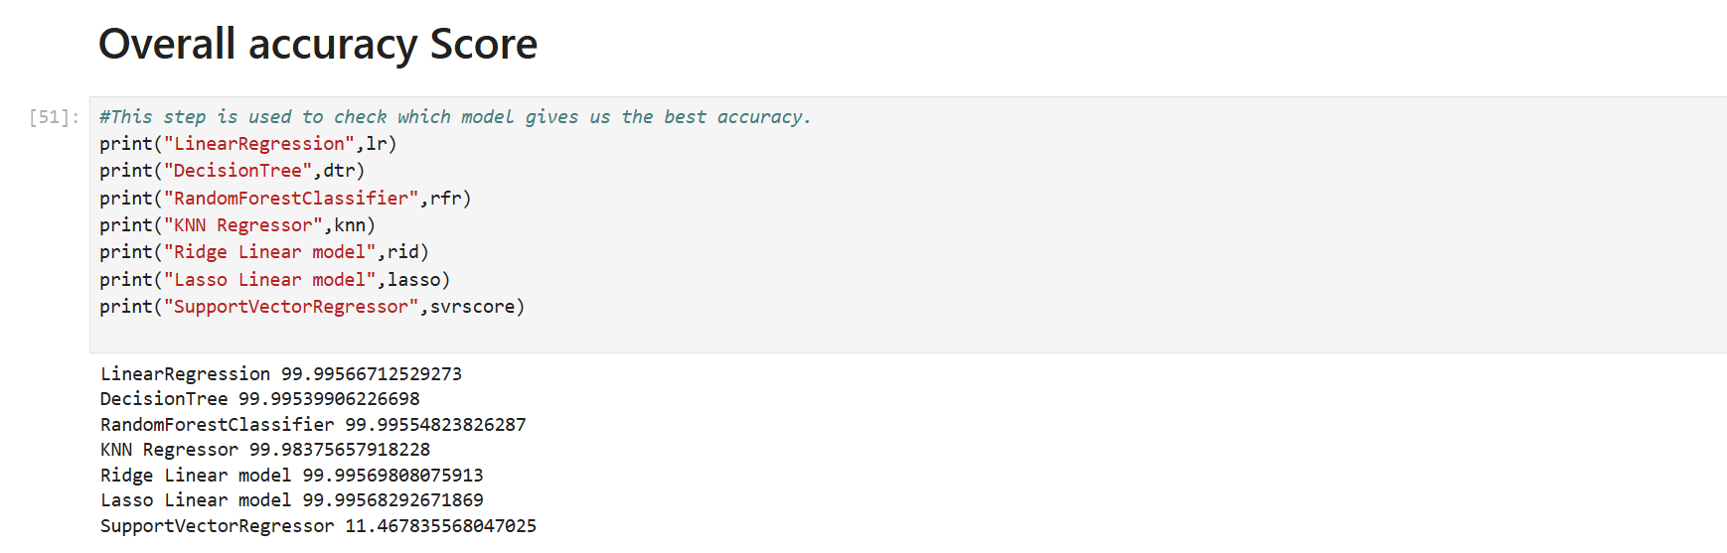

Slide 24
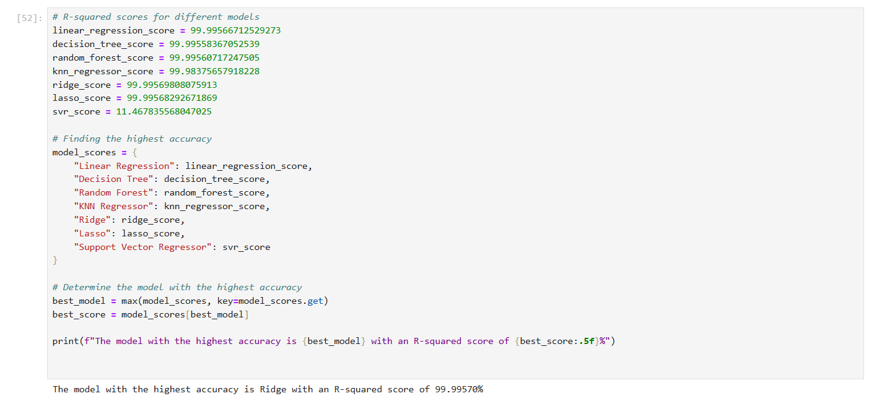

Slide 25
Conclusion:
In this project, we build various models like Linear Regression, Decision Tree, Random Forest Classifier, K-Nearest Neighbors (KNN) Regressor, Ridge Regression, Lasso Regression, and Support Vector Regressor.
A Ridge algorithm gives the highest accuracy score of 99.99570 percent among all the ML Models.
Thus, for the House Price Prediction Dataset, the best accuracy can be achieved using Ridge algorithm Model.
THANK YOU!

